Slide 1
BankBot Digital assistant INVESTEC PROGRAMMABLE BANKING INCLUDING BETA TRANSFER FUNCTIONALITY
Revision/Version: 1.4
Author: Russell Knight B.Comm. B.Compt. Hons. CA(SA)

Slide 2

Overview
BankBot digital assistant is an automated solution for personal finance tracking and reporting.
The solution is housed within an MS Excel Workbook.
Automation is primarily achieved via VBA (Visual Basic for Applications) coding.

Slide 3

Why did I create BankBot?
Personal objective of responsibly automating menial tasks in my life to free up time for more meaningful activity.
Enhance my coding and analysis skills in the process.
To break some new ground (progressiveness).
For fun. 😁
The remote possibility that some commercial application of the concept could be derived in the future.

Slide 4

Enablers/Platforms
MS Excel – House parameters and data as well as reports.
Visual Basic for applications (VBA)
​Windows task scheduler – Kick off process on schedule.
​​VB Script executed via Wscript – Load Excel workbook and execute VBA code.
​Telegram Bot API – For instant messaging. (Whatsapp rules for engagement too burdensome)

Slide 5

Major functions
​Parameter storage.
API token acquisition.
API banking transaction data retrieval.
Transaction classification ruleset maintenance.
Ingestion of API data together with automated classification.
​Association of transactions with link to supporting documentation + warnings of missing documentation.
​Budget burn rate tracking on expense categories.
Send summarised and enriched instant messaging of each major Bot activity.
​Reporting against budget, enriched with conditional formatting + drill-down capability.
Automated transfers to keep main account from falling into overdraft state.

Slide 6

API Token
API Token is stored in Parameter worksheet with an associated timestamp.
API call execution evaluates whether the Token has expired.
If Token is still valid, API call is executed.
If token has expired, generates new Token.
This was the most significant challenge of the entire project for me (30% of project time).
Placed a summary of learning on Programmable banking community page.

Slide 7
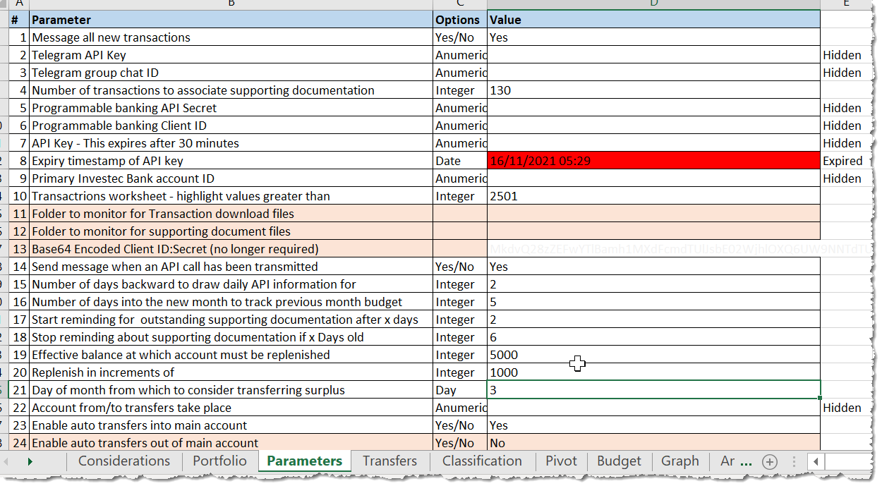
Parameters worksheet

Slide 8
Automation
Windows task scheduler initiates activity based upon schedule (currently once per day, but could occur more frequently).
Task is set to wake the computer, which is left in “sleep” mode.
A VB Script opens BankBot Excel workbook and executes the VBA code to retrieve banking transactions.

Slide 9
Classification ruleset
User can maintain classification rules based upon key words in the Descriptor.
​Three levels of classification to facilitate drill-down reporting later.
Indication as to whether supporting documentation is expected (will warn if missing).
Indication as to whether a percentage SinTax is applicable to the transaction.

Slide 10
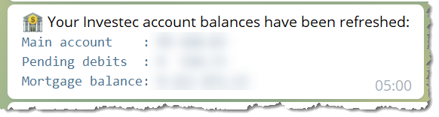
Account balances
All Investec account balances are updated and linked to wider personal financial portfolio spreadsheet.
​Pending transaction value is calculated.
Telegram message is sent summarising key information.
Automated updating of Forex rate from Forex website to enable conversion of USD denominated values at refreshed rate.

Slide 11
Automated transfers 1/2
A parameter is maintained, indicating the minimum and maximum level of balance to target.
Cognisance is taken of the sudden outflow of funds due to debit and stop orders at the beginning of the month.
Each morning a calculation is done to ascertain whether the account is in the acceptable range.
Transactions that are pending are taken into account for this calculation.
An automated transfer is processed in rounded UP in multiples of R1000 to restore the balance to the “Goldilocks” range.
A message is transmitted, giving details of the transfer transaction. Descriptor includes indication of the target level that gave rise to transaction.

Slide 12
Automated transfers 2/2
Auto-classified expenditure has associated SinTax calculated if applicable. Calculation is stored on the transaction record line.
SinTax is tallied up for the batch of ingested transactions.
SinTax total for the batch is automatically transferred from the Main banking account to the designated SinTax account.
A distilled instant message is transmitted to confirm the transfer.

Slide 13

API Banking Transactions
Last data point of ingestion is checked to determine date range to make the API request for.
Last API retrieval is cleared to make way for new retrieval.
API Token is retrieved from Parameters worksheet.
​​API call to Investec server is made.
API JSON response is received, parsed and populated into a temporary worksheet for next process.
Instant message sent, summarising result.

Slide 14
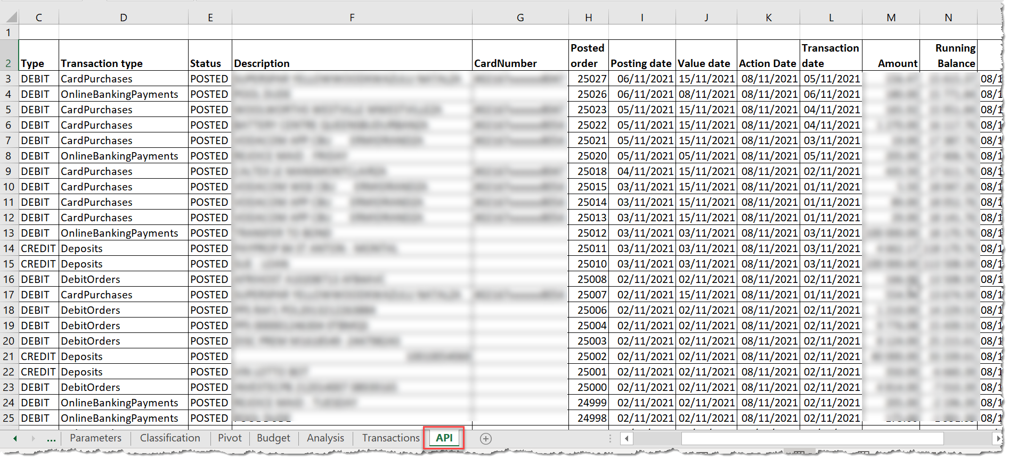
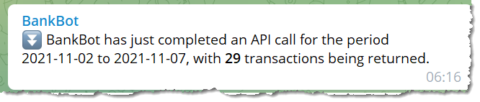
Example API result

Slide 15

Transaction Ingestion
BankBot compares API Transactions result to prior transactions ingested to establish new transaction data (avoid duplication of records).
New transaction data is ingested into the Master transaction worksheet.
​Automated classification of transactions takes place.
Distilled result instant message is despatched.
PivotTable is automatically refreshed for reporting by Classification.

Slide 16
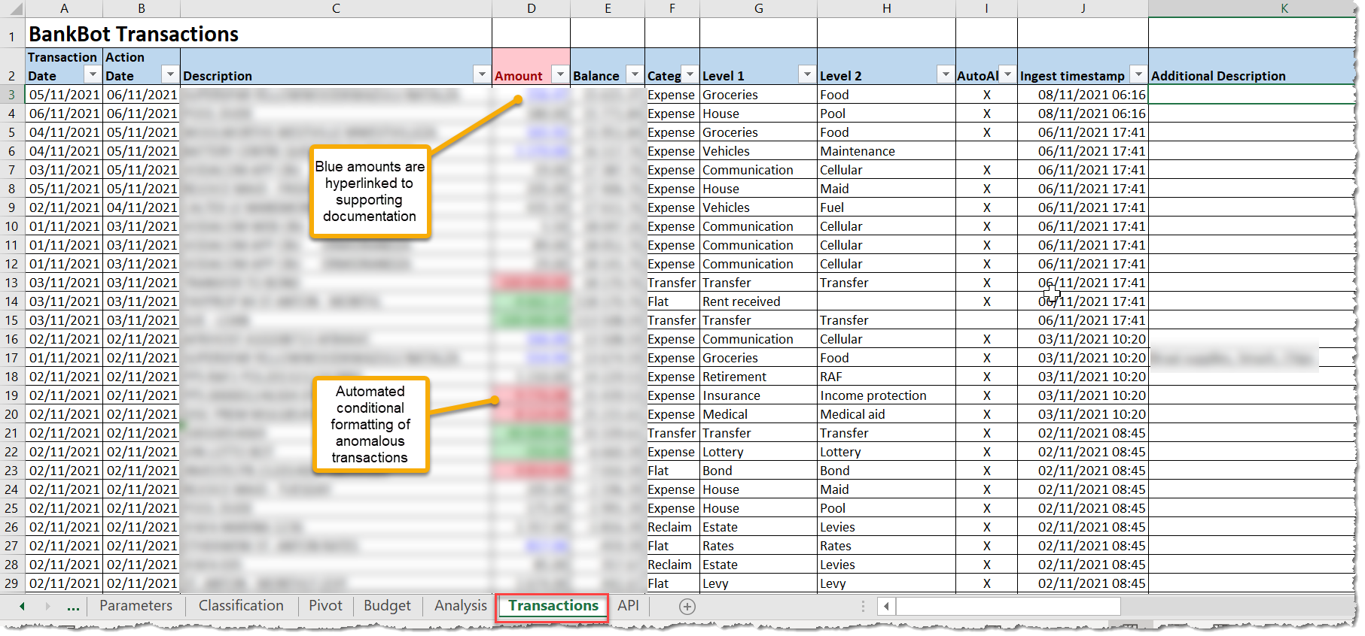
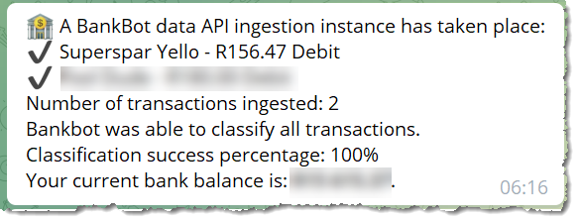
Example ingested transactions

Slide 17

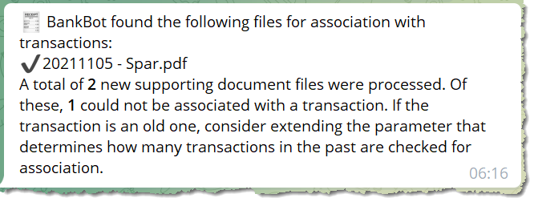
Association with supporting docs
Supporting electronic documentation is placed in a monitored folder with a specific filename convention.
After ingestion of API records, BankBot performs automated association of supporting documentation with transactions.
The associated supporting document is transferred/moved to a “Processed” repository.
A link to the supporting document is created.
A distilled instant message summarising the results is sent.

Slide 18
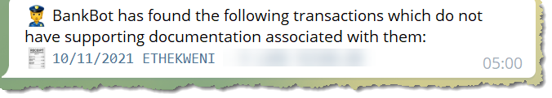
Missing documentation notification
Each auto-classification of transactions carries with it a flag confirming whether supporting documentation is expected.
Conditional formatting to highlight missing documentation.
Daily assessment of missing documentation within parameter timeframe.
Telegram message with detail of outstanding documentation.

Slide 19
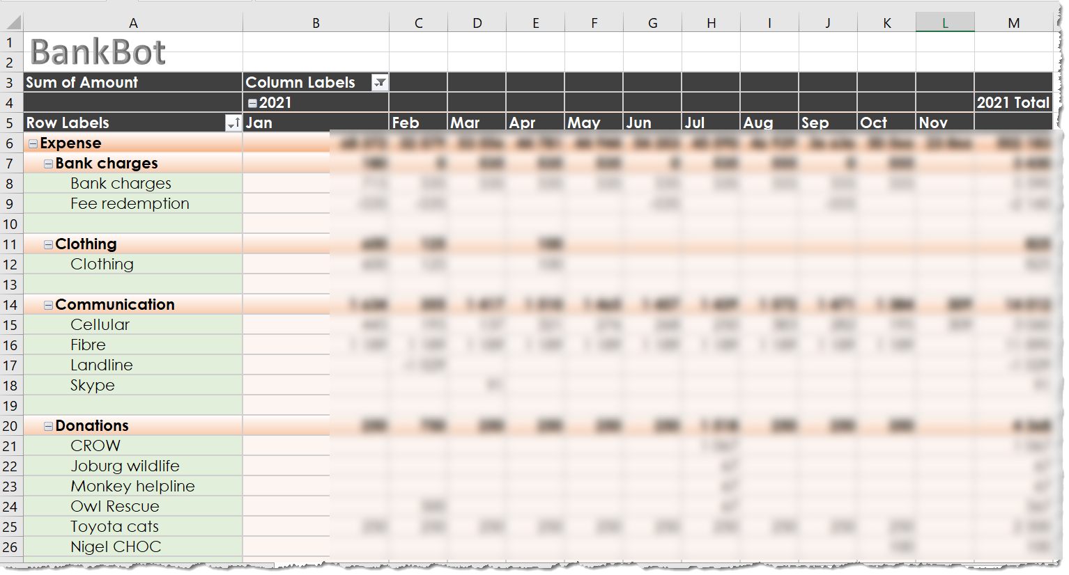
Reporting Month to month

Slide 20
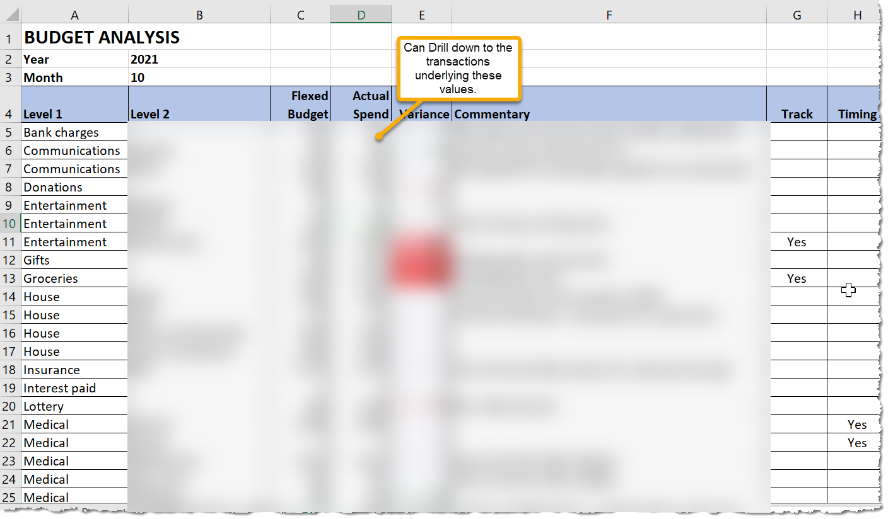
Reporting against budget

Slide 21
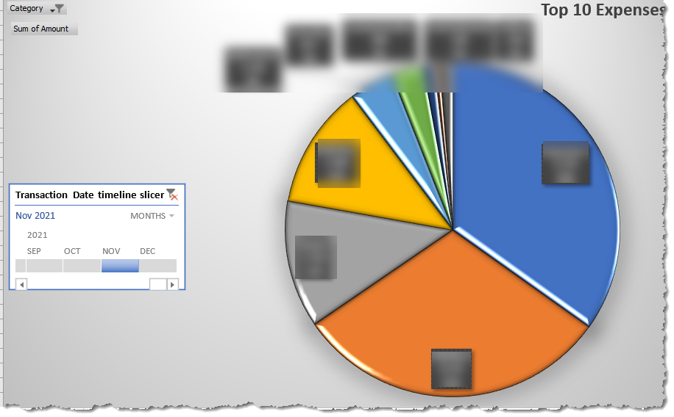
Interactive graph of expenditure

Slide 22
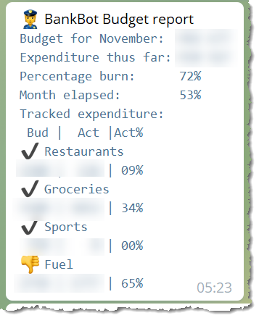
Automated budget track
User flags expenses to be controlled/tracked e.g. Entertainment: Restaurants and takeaways.
BankBot calculates expense “burn” percentage relative to days of month expired.
Telegram message sent daily indicating total state and the following for tracked expenses:
Budgeted expenditure
Actual expenditure for month to date
Percentage “burn%” of budget
Indicator for whether burn% exceeds month burn%

Slide 23
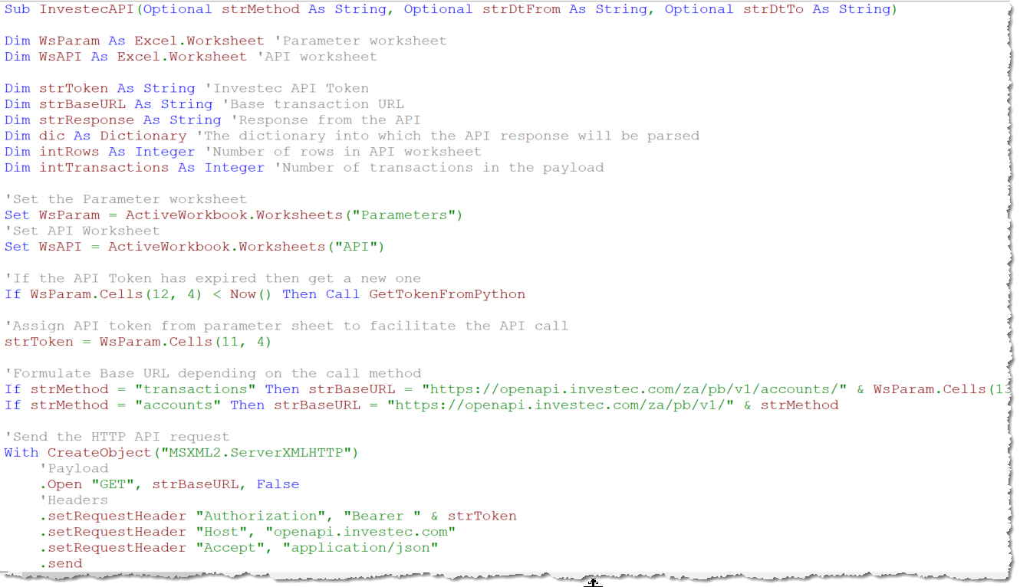
Code snippet example

Slide 24

Where is the value offering?
Automated data retrieval.
Automated classification of 95% of transactions.
Distilled rich messaging.
Enriched reporting.
All data is available in a universally accepted standard spreadsheet application.
​Interrogation (Drill-down and filtering) functionality
Link association between supporting documents and transactions.
Automated transfers and balance maintenance.
Provision for a SinTax to influence spending behaviour.

Slide 25

Next steps?
Consider security aspects (potential exposure of Client_ID, Client_Secret, Token)
Improve cosmetics of solution – this was a rough and ready POC.
Robust testing of solution, seeking anomalies.
Evaluate mechanisms for deployment to test with a User e.g. as an Excel add-in?

Slide 26

Issues to consider
Allowing VBA code to be run could expose machines to malign scripting from other sources – primary reason VBA has not taken off I think.
Insecure storage of sensitive information (Token and credentials).

Slide 27
Project conclusion
I need to earn a lot more money so that I can volume test BankBot properly!

Slide 28

END OF PRESENTATION Thanks for reading/listening

